Slide 1
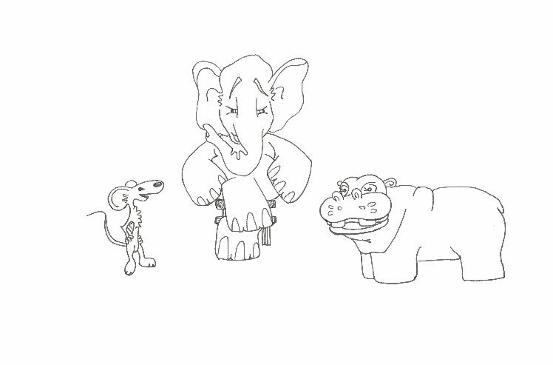
Foundations of Software Testing
Chapter 5: Test Selection, Minimization, and Prioritization for Regression Testing
Last update: September 3, 2007

Slide 2
What is regression testing?

Slide 3
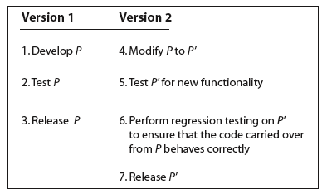
Regression testing

Slide 4
What tests to use?
TEST-ALL:
All valid tests from the previous version and new tests created to test any added functionality.
The TEST-ALL approach is best when you want to be certain that the new version works on all tests developed for the previous version and any new tests.
But what if you have limited resources to run tests and have to meet a deadline?

Slide 5
Test selection
Select a subset Tr of the original test set T such that successful execution of the modified code P’ against Tr implies that all the functionality carried over from the original code P to P’ is intact.
Tr can be found using several methods.
-- test minimization
-- test prioritization

Slide 6
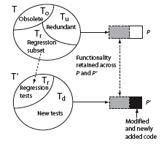
Regression Test Selection problem
Given test set T, our goal is to determine Tr such that successful execution of P’ against Tr implies that modified or newly added code in P’ has not broken the code carried over from P.
Some tests might become obsolete when P is modified to P’.
Such tests are not included in the regression subset Tr.

Slide 7
Test selection using execution trace and execution slice

Slide 8
Overview of a test selection method
Step 1: Given P and test set T, find the execution trace of P for each test in T.
Step 2: Extract the test vector -- test(n) -- from the execution traces for each node n in the CFG of P.
Step 3: Build syntax trees for each node in the CFGs of P and P’.
Step 4: Traverse the CFGs and determine a subset of T appropriate for regression testing of P’.

Slide 9
Execution Trace
Let G=(N, E) denote the CFG of program P.
N is a finite set of nodes and E a finite set of edges.
Suppose that nodes in N are numbered 1, 2, and so on, and that Start and End are two special nodes.
Let Tno be the set of all valid tests for P’.
Tno is obtained by discarding all tests that have become obsolete.

Slide 10
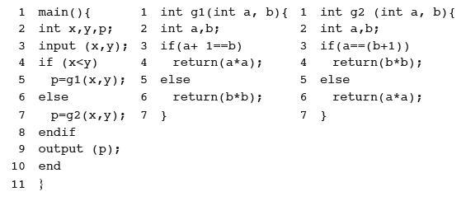
Execution Trace
An execution trace of program P for some test t in Tno is the sequence of nodes in G traversed when P is executed against t. As an example, consider the following program.

Slide 11
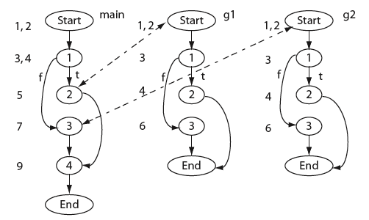
Execution Trace
Here is a CFG for our example program.

Slide 12

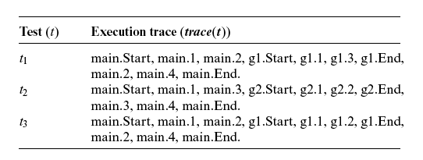
Execution Trace
Consider the following set of three tests and the corresponding trace.

Slide 13
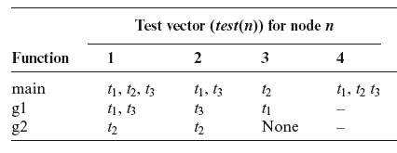
Test vector
A test vector for node n, denoted by test(n), is the set of tests that traverse node n in the CFG. For program P we obtain the following test vectors.

Slide 14
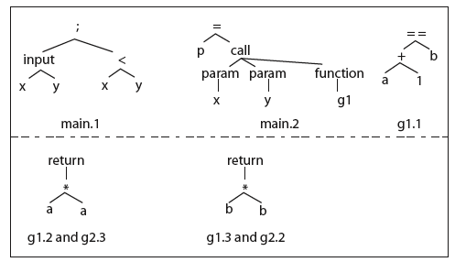
Syntax trees
A syntax tree is built for each node of CFG(P) and CFG(P’).
Recall that each node represents a basic block.
Here are sample syntax trees for the example program.

Slide 15
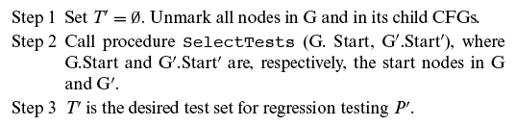
Test selection
Given the execution traces and the CFGs for P and P’, the following three steps are executed to obtain a subset T’ of T for regression testing of P’.

Slide 16
Test selection
The idea underlying procedure SelectTests is to traverse the two CFGs from their respective START nodes using a recursive descent procedure.
The descent proceeds in parallel and corresponding nodes are compared.
If two corresponding nodes n in CFG(P) and n’ in CFG( P’) are found to be syntactically different, all tests in test(n) are added to T’.

Slide 17
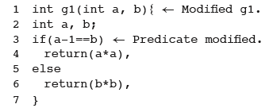
Test selection example
Suppose that function g1 in P is modified as follows.
Try the SelectTests algorithm and check if you get T’={t1, t3}.

Slide 18
Test selection using dynamic slicing

Slide 19
Dynamic slice
Let L be a location in program P and v a variable used at location L.
Let trace(t) be the execution trace of P when executed against test t.
The dynamic slice of program P with respect to test t, variable v, and location L, denoted as DS(t, v, L), is the set of statements in P that lie in trace(t) and affect the value of v at location L.
Question: What is the dynamic slice of P with respect to v, t, and L, if L is not in trace(t)?

Slide 20
Dynamic dependence graph (DDG)
The DDG is needed to obtain a dynamic slice.
Here is how a DDG G is built.
Step 1: Initialize G with a node for each declaration.
There are no edges among these nodes.
Step 2: Add to G the first node in trace(t).
Step 3: For each successive statement in trace(t), add to G a new node n. Then add control and data dependence edges from n to the existing nodes in G.
[Recall from Chapter 1 the definitions of control and data dependence edges.]

Slide 21
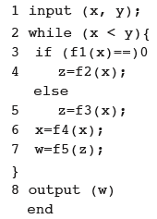
Construction of a DDG: Example [1]
t: <x=2, y=4>
Assume successive values of x to be 2, 0, and 5 and for these f1(x) is 0, 2, and 3 respectively.
trace(t)={1, 2, 3, 4, 6, 7, 2’, 3’, 5, 6’, 7’, 2’’, 8}
0)
For simplicity, we ignore declarations.
Add a node to G corresponding to statement 1.
1

Slide 22
Construction of a DDG: Example [2]
trace(t)={1, 2, 3, 4, 6, 7, 2, 3, 5, 6, 7, 2, 8}
Add another node corresponding to statement 2 in trace(t). Also add a data dependence edge from 2 to 1 as statement 2 is data dependent on statement 1.
0)
1
2
Add yet another node corresponding to statement 3 in trace(t). Also add a data dependence edge from node 3 to node 1 as statement 3 is data dependent on statement 1 and a control edge from node 3 to 2.
1
2
3

Slide 23
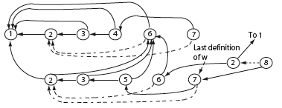
Construction of a DDG: Example [3]
trace(t)={1, 2, 3, 4, 6, 7, 2, 3, 5, 6, 7, 2, 8}
Continuing this way we obtain the following DDG for program P and trace(t).
0)

Slide 24
Obtaining dynamic slice (DS)
Step 1: Execute P against test t and obtain trace(t).
Step 2: Build the dynamic dependence graph G from P and trace(t).
Step 3: Identify in G node n labeled L that contains the last assignment to v. If no such node exists then the dynamic slice is empty, otherwise execute Step 4.
Step 4: Find in G the set DS(t, v, n) of all nodes reachable from n, including n itself. DS(t, v, n) is the dynamic slice of P with respect to v at location L and test t.

Slide 25
Obtaining dynamic slice: Example
Suppose we want to compute the dynamic slice of P with respect to variable w at line 8 and test t shown earlier.
We already have the DDG of P for t.
First, identify the last definition of w in the DDG.
This occurs at line 7 as marked.
Traverse the DDG backwards from node 7 and collect all nodes reachable from 7.
This gives us the following dynamic slice: {1, 2, 3, 5, 6, 7}.

Slide 26
Test selection using dynamic slice
Let T be the test set used to test P. Let P’ be the modified program.
Let n1, n2, …,nk be the nodes in the CFG of P modified to obtain P’.
Which tests from T should be used to obtain a regression test T’ for P’?
Find DS(t) for P.
If any of the modified nodes is in DS(t), then add t to T’.

Slide 27
Test selection using test minimization

Slide 28
Test minimization
Test minimization is yet another method for selecting tests for regression testing.
To illustrate test minimization, suppose that P contains two functions: main and f.
Now suppose that P is tested using test cases t1 and t2.
During testing it was observed that t1 causes the execution of main but not of f while t2 causes the execution of both main and f.

Slide 29
Test minimization
Now suppose that P’ is obtained from P by making some modification to f.
Which of the two test cases should be included in the regression test suite?
Obviously there is no need to execute P’ against t1 as it does not cause the execution of f.
Thus the regression test suite consists of only t2.
In this example we have used function coverage to minimize a test suite {t1, t2} to a obtain the regression test suite {t2}.

Slide 30
Test minimization
Test minimization is based on the coverage of testable entities in P.
Testable entities include, for example:
- program statements
- decisions
- def-use chains
- mutants.
One uses the following procedure to minimize a test set based on a selected testable entity.

Slide 31
A procedure for test minimization
Step 1: Identify the type of testable entity to be used for test minimization. Let e1, e2, …, ek be the k testable entities of type TE present in P.
In our previous example, TE is “function”.
Step 2: Execute P against all elements of test set T and, for each test t in T,
determine which of the k testable entities is covered.
Step 3: Find a minimal subset T’ of T such that each testable entity is covered by at least one test in T’.

Slide 32
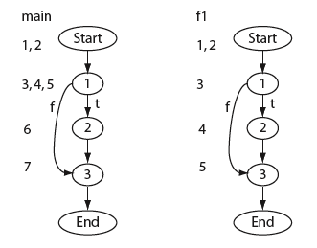
Test minimization: Example
Step 1: Let the basic block be the testable entity of interest.
The basic blocks for a sample program are shown here for both main and function f1.
Step 2: Suppose the coverage of the basic blocks, when executed against three tests, is as follows:
t1: main: 1, 2, 3. f1: 1, 3
t2: main: 1, 3. f1: 1, 3
t3: main: 1, 3. f1: 1, 2, 3
Step3: A minimal test set for regression testing is {t1, t3}.

Slide 33
Test minimization
Minimal test set is not unique.
Test minimization is NP hard. Hitting set problem.
Various testable entities can be used for minimization – blocks, branch outcomes, uses etc.

Slide 34
Test selection using test prioritization

Slide 35
Test prioritization
Test minimization discards test cases.
There is a chance that, if P’ were executed against a discarded test case, it would reveal an error in the modification made.
When very high quality software is desired, it might not be wise to discard test cases as in test minimization.
In such cases one uses test prioritization.
Tests are prioritized based on some criteria. For example, tests that cover the maximum number of a selected testable entity could be given the highest priority, the one with the next highest coverage the next higher priority, and so on.

Slide 36
A procedure for test prioritization
Step 1: Identify the type of testable entity to be used for test minimization. Let e1, e2, …, ek be the k testable entities of type TE present in P.
In our previous example TE is “function”.
Step 2: Execute P against all elements of test set T and for each test t in T. For each t in T, compute the number of distinct testable entities covered.
Step 3: Arrange the tests in T in order of their respective coverage.
Test with the maximum coverage gets the highest priority and so on.

Slide 37
Using test prioritization
Once the tests are prioritized, one has the option of using all tests for regression testing or a subset of them.
The choice is guided by several factors, such as the resources available for regression testing and the desired product quality.

Slide 38
Summary
Regression testing is an essential phase of software product development.
In a situation where test resources are limited and deadlines are to be met, execution of all tests might not be feasible.
In such situations, one can use sophisticated technique for selecting a subset of all tests and reduce the time for regression testing.

